Slide 1

Introduction to Computer Science: Programming Methodology
Tutorial 4
Flow control
ustf - Li Peijie
email: 121090274@link.cuhk.edu.cn

Slide 2
Outline
1. Idea of flow control.
2. Conditional flows.
3. Repeated flows:
i) For loops; ii) While loops.
4. Break and Continue.
5. Try/except.

Slide 3
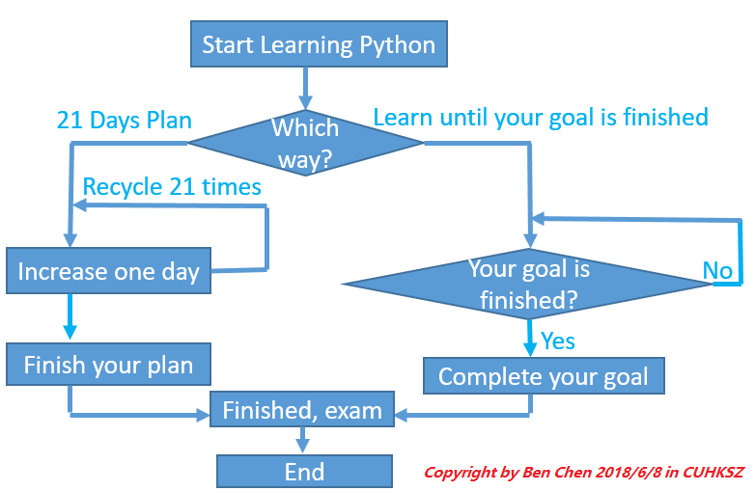
1.Idea of flow control
Flow control: execute individual statements, instructions or function calls in a specific order – one line by one line from up to down.
Look at the flow chart on the left – imagine a water flow from start to end.
1. If statement: conditional flow
2. Loops: repeated flow(while loop and for loop)

Slide 4
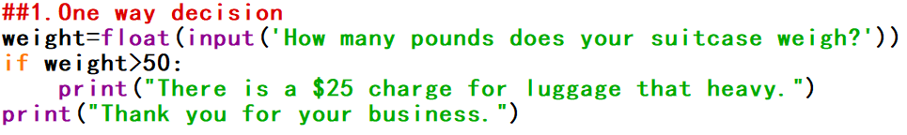
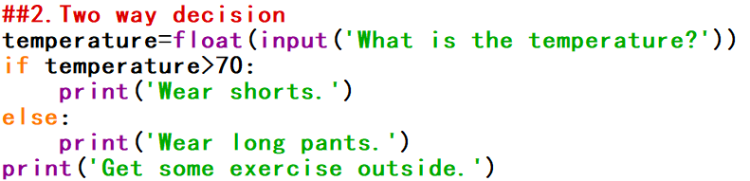
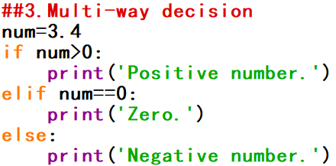
2. Conditional flow
Conditional flow (or “Decision flow”):
1. One way decision (if); 2. Two way decision (if, else); 3. Multi-way decision (if, elif, …, else).

Slide 5

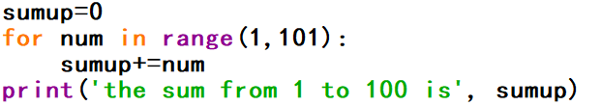
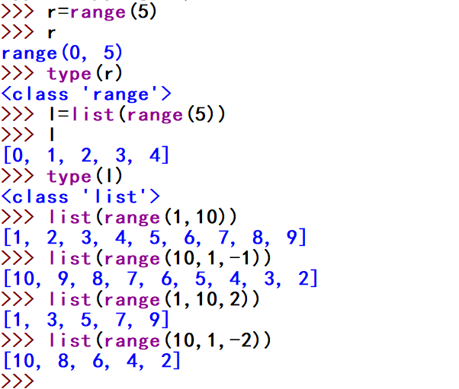
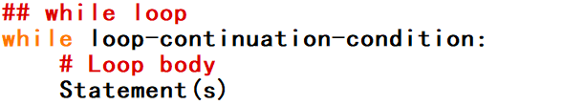
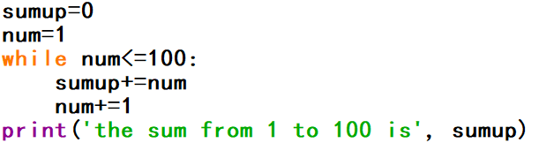
3.Repeated flow
Use loops to execute statements repeatedly.
About range()
* In range(init, end, step), “init” is included but “end” is not.
*range() can be changed into list types
*range(init, end) means from init to end-1;
*range(init, end, -1) means from init to end+1 step=-1.

Slide 6
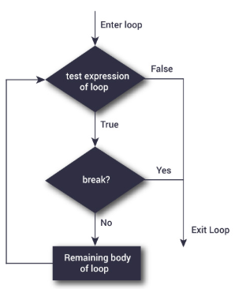
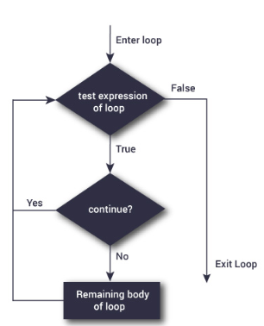
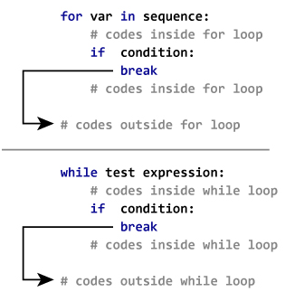
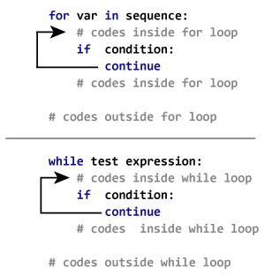
4.Break and Continue
break
continue
In Python, break and continue statements can alter the flow of a normal loop.
The break statement terminates the loop containing it. Control of the program flows to the statement immediately after the body of the loop.
The continue statement is used to skip the rest of the code inside a loop for the current iteration only. Loop does not terminate but continues on with the next iteration.

Slide 7
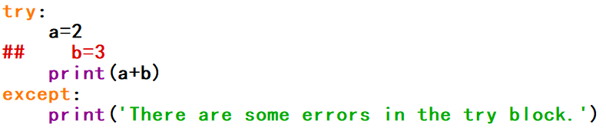
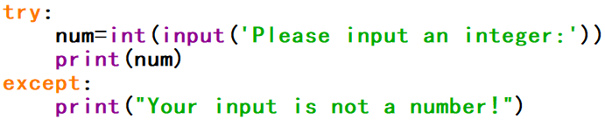
5.Try/except
Use try/except to capture the error in your code.
The try block lets you test a block of code for errors. If the code in it is good, it will run normally; otherwise, if with errors, it can be skipped, without the program being terminated.
The except block lets you handle the error.
* If variable “b” is defined, nothing wrong with try block;
otherwise except block will be executed as a warning.
* If an integer is input, the program is fine; if, however, what is input is not an integer, like letters “abc”, a warning to the user occurs.

Slide 8
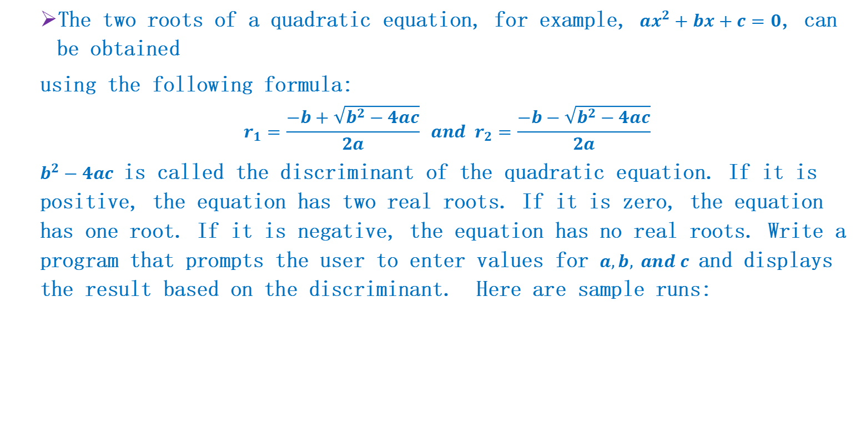
Q1: Quadratic equation
The two roots of a quadratic equation, for example, $ax^{2}+bx+c=0$, can be obtained
using the following formula:
$$r_{1}=\frac{−b+\sqrt{b^{2}−4ac}}{2a} and r_{2}=\frac{−b−\sqrt{b^{2}−4ac}}{2a}$$
$b^{2}−4ac$ is called the discriminant of the quadratic equation. If it is positive, the equation has two real roots. If it is zero, the equation has one root. If it is negative, the equation has no real roots. Write a program that prompts the user to enter values for $a,b, and c$ and displays the result based on the discriminant. Here are sample runs:

Slide 9


Q2: Days in a month
Write a program that prompts the user to enter the month and year and displays the number of days in the month. For example, if the user entered moth 2 and year 2000, the program should display that February 2000 has 29 days. If the user entered month 3 and year 2005, the program should display the March 2005 has 31 days. Here are sample runs:

Slide 10
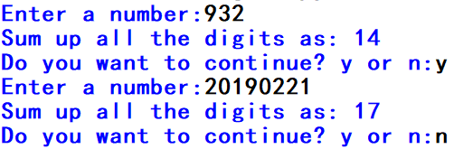
Q3: Sum the digits
Previously we write a program that reads an integer between 0 and 1000 and adds all the digits in the integer. For example, if an integer is 932, the sum of all its digit is 14. Now please use while loop to solve this problem. Your code should be able to handle numbers greater than 1000.

Slide 11
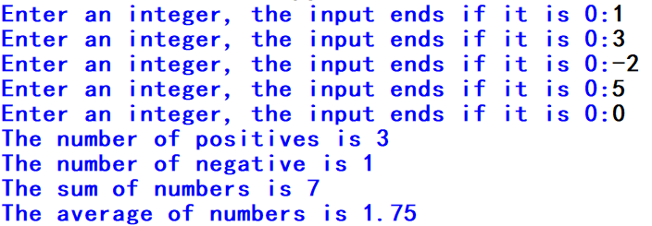
Q4: Count numbers
Write a program that reads an unspecified number of integers, determines how many positive and negative values have been read, and computes the total and average of the input values (not counting zeros). Your program ends with the input 0. Display the average as a floating-point number. Here is a sample run:

Slide 12
Q5: Find factors
Write a program that reads an integer and displays all its smallest factors, also known as prime factors. For example, if the input integer is 120, the output should be as follows:
2,2,2,3,5

Slide 13
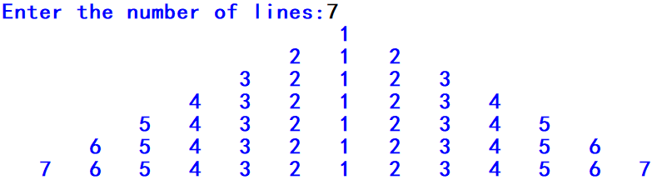
Q6: Display a pyramid
Write a program that prompts the user to enter an integer from 1 to 15 and displays a pyramid with height of that integer, as shown in the following sample run:

